Slide 1

GitHub Copilot Deployment & Operational Management
This presentation outlines our strategy for integrating GitHub Copilot, focusing on operational management, adoption, and realizing tangible business value.

Slide 2
Deployment Roadmap & Key Milestones
November 2025
June 2026
Initial Training & Setup
First CASPL Training
Define Operational Management
First CASPL Copilot training on June 09.
Define Success Criteria
86 licenses provisioned.
1
2
3
4
February 2026
November 2026
SG Copilot Training
Review & Expansion
DEC SG Copilot training on Feb 08.
Complete all training.
Brief delay due to IFI.
Follow up operational KPIs.
Review Success KPIs.
Initiate wider Copilot adaptation.
Our phased deployment ensures a smooth transition and comprehensive adoption across all teams.

Slide 3
DEC Actions: Fostering Copilot Adoption
Organizational Structure
A Monthly Operational Committee is formed, and NSU for Singapore is completed, ensuring dedicated oversight.
Empowering Champions
Tech leads serve as champions, and team heads act as operational managers, driving grassroots adoption.
Training & Support
Regular training is planned, complemented by self-service grant access (MSGHCP), with Vinodh S. from BLAO as a core member.

Slide 4

Maximizing GenAI Adoption with GitHub Copilot
GitHub Copilot is an assistive tool; its output requires review. Developers are encouraged to engage in feedback loops and collaborative working sessions to maximize its benefits.
Hands-On Training
Regular feedback sessions to integrate GenAI into workflows.
Collaborative Sessions
Promote joint work to help developers adopt GenAI effectively.
Effort Estimation
Demonstrate how GenAI assists in code generation and problem-solving.
Continuous Learning
Foster adaptation to maximize benefits of GenAI technologies.

Slide 5
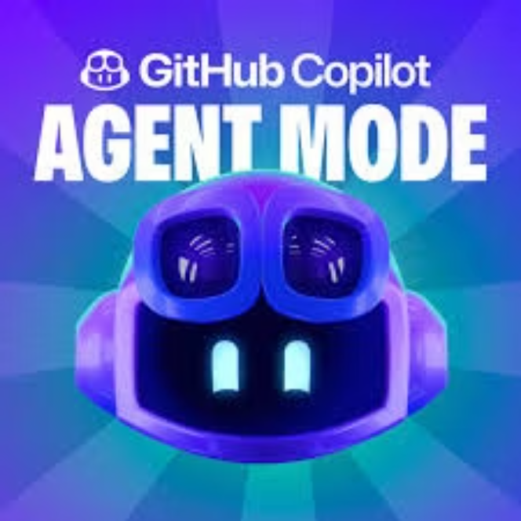
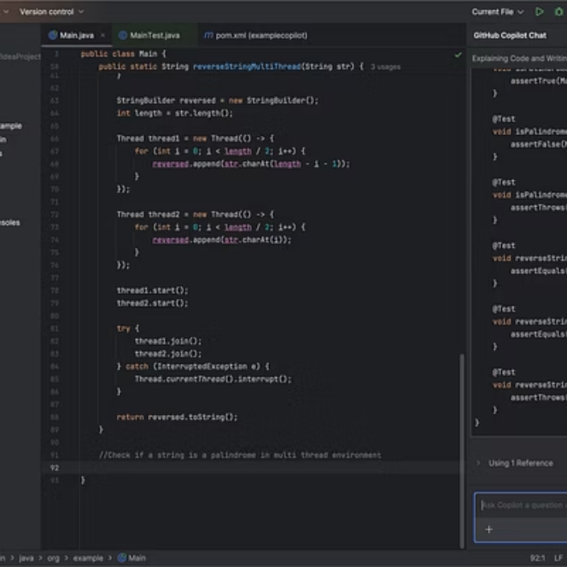



GitHub Copilot: Enhanced Agentic Features
GitHub Copilot agents are specialized AI tools designed to enhance the capabilities of GitHub Copilot in specific areas, like coding or managing tasks within a repository. They are integrated with Copilot Chat and can perform multi-step tasks, suggest code improvements, and even handle tasks like creating pull requests autonomously. Essentially, they act as specialized AI assistants that can be leveraged to automate and streamline various development workflows.

Slide 6
Business Use Cases & ROI
Modernization of Applications
Build Base Application
Extend Application Features
Develop UI, backend services, SQL scripts, and documentation.
Upgrade outdated libraries and increase code coverage.
Implement new features with robust code quality and unit tests.
Up to 50% reduction in development effort.
Estimated 30% reduction in development effort.
Typical duration: 20 days for standard apps.
30% reduction in development effort.
Example: DROP project, 20 man-days saved.
Example: ELENA project for feature extension.

Slide 7
Business Use Cases & ROI
Modernization of Applications
Build Base Application
Extend Application Features
Develop UI, backend services, SQL scripts, and documentation.
Upgrade outdated libraries and increase code coverage.
Implement new features with robust code quality and unit tests.
Up to 50% reduction in development effort.
Estimated 30% reduction in development effort.
Typical duration: 20 days for standard apps.
30% reduction in development effort.
Example: DROP project, 20 man-days saved.
Example: ELENA project for feature extension.

Slide 8
Extended Business Use Cases
Vulnerability Management
Test Automation
Identify and upgrade outdated libraries to enhance security and reduce risks.
Implement automated UI and API testing to reduce bugs and improve reliability.
Improve Code Coverage
Application Documentation
Develop missing unit tests and integrate with SonarQube for quality analysis.
Prepare comprehensive documentation for enhanced support and knowledge sharing.

Slide 9
General Benefits of GitHub Copilot
Code Completion
Autocompletes snippets, functions, or entire methods.
Boilerplate Generation
Quickly generates repetitive code like CRUD operations.
Learning New Features
Helps discover and use unfamiliar libraries/frameworks.
Code Translation
Converts code between programming languages (e.g., Java → Python).
Comment-to-Code
Converts natural language comments into working code.
Refactoring Suggestions
Suggests cleaner or more idiomatic alternatives.
Test Writing
Auto-generates unit tests based on code or function signature.

Slide 10
Case Study: Create Application Base Features (MESARI)
Business Case
Implementation with Copilot
Return on Investment
MESARI: Develop Risk Analysis features faster using Copilot, aiming to reduce manual development time for repetitive tasks.
Prepare prompts for UI, API, and database creation, enforcing coding standards. Feed prompts to Copilot Agent, review, accept, and test in Dev environment.
Automated bootstrapping ensures rapid deployment and standardized practices.
Estimated savings: 5 man-days per application.
Potential savings: >500 man-days for 100+ applications.
All apps adhere to defined coding standards.

Slide 11
Case Study: Application Modernization (DROP) & Extension (ELENA)
DROP: Modernization & Cloud Migration
ELENA: Fileshare Access Management
Centralized DRP/BCP system for NY, CAGIP, CACIES. Migrating legacy 2010 solution to Spring Boot for cloud deployment and improved availability.
Leveraging Copilot to accelerate development of new business logic, UI, and unit tests for enhanced features.
Implementation: Use Agentic features, create unit tests, and generate Docker/Kubernetes configurations.
Implementation: Prepare prompts for UI, API, and business logic while enforcing coding standards.
ROI: 3,400+ apps reviewed; 500+ eligible for upgrade. Estimated 5,000 man-days saved.
ROI: Accelerated feature delivery. Estimated 250+ man-days saved for 50+ applications, adhering to standards.

